Slide 1
Maze Game COMP5511 Artificial Intelligence Concepts Group Project Group Member: Chen Qi 18083945G Gao Huahui 18071699G Wang Di 18075629G Su Gengmin 18003394G Zhao Haiqi 18087348G

Slide 2
Index
Introduction
Game Play
Algorithm
Implementation
Demo
Conclusion

Slide 3
1.
Introduction
Let’s start with the first set of slides

Slide 4
This project is aiming at realizing a game AI with reinforcement learning concepts learned in class and comprising it in the game designed by us.
Notes:
The objective of our project is aiming at realizing a game AI with reinforcement learning concepts learned in class and comprising it in the game designed by us.

Slide 5
Introduction
Design
Suits AI player
Reasonable Time
Difficulty
First-person Perspective
Background
Algorithm
ML-agents
Prototype
Notes:
In the game design, we wanted to design a game that suits using AI player in the game to play against human player. Besides, the game should have reasonable time period and a certain of difficulty. To achieve this goal, we designed a maze game with first person perspective paly mode. We are going to use reinforcement learning in this project. ML-agents is a helpful API which we can used to train our AI.

Slide 6
2.
Game Play

Slide 7
Find the Escape Point
That is the core game play and rule!

Slide 8
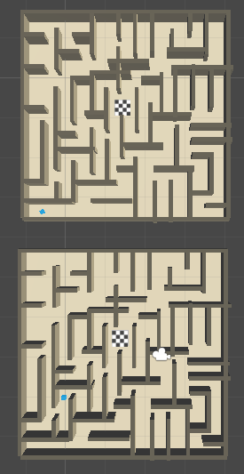
Game Play
Human-Computer Competition
Start at the same time
Same field
15 rounds in total
First finish win
Notes:
Two same maze are here for AI and human player. The human-computer competition mode will let AI player and human player start the game at the same time. They will play the game in the same kind of maze filed with 15 rounds in total. The first one who finish the 15 rounds will be the winner and end the game.

Slide 9
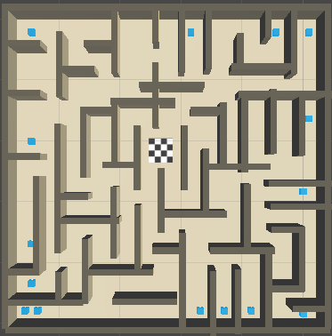
15 Spawn points
Notes:
Here is the picture show that there are 15 spawn points in total. In each round, the player will born in one of the 15 points. The order are static which means that in the Nth round, the player will start from a same spawn point everytime.

Slide 10
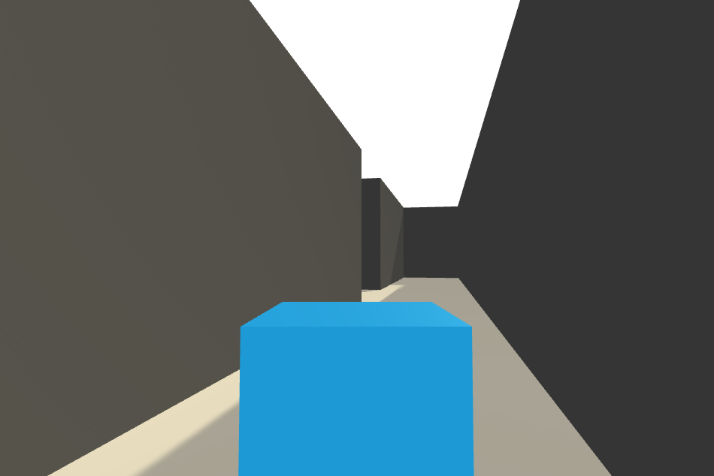
Game Play
Scene
First-person Perspective
Brown solid flat floor
Black squared solid wall
Notes:
Here the picture shows the first-person perspective in the game. The brown sold flat is the floor and the black squared solid object is the wall. The player can not be able to go or look through the wall directly.

Slide 11
3.
Algorithm

Slide 12
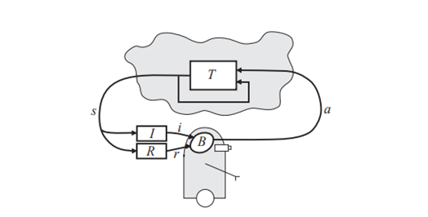
Reinforcement Learning
Reinforcement Learning Model
Notes:
Reinforcement learning is a branch of machine learning, which can solve problems with an agent that perceives the information of the environment. Instead of teaching the agent which action to take under certain environment in advance, the agent must constantly try various actions to get the optimal policy.
According to Richard S. Sutton and Andrew G. Barto, there are four more main elements in reinforcement learning except for agent and environment: a policy, a reward signal, a value function and environment model.

Slide 13
Deep Reinforcement Learning
Main Algorithms of Deep Reinforcement Learning
Algorithms | Year | Based on
Deep Q Network (DQN) | 2013 | Value
Nature DQN | 2015 | Value
Deep Deterministic Policy Gradient (DDPG) | 2015 | Policy
Proximal Policy Optimization (TRPO) | 2015 | Policy
Asynchronous Advantage Actor-Critic (A3C) | 2016 | Policy
Unsupervised Reinforcement and Auxiliary Learning (UNREAL) | 2016 | Policy
Distributed Proximal Policy Optimization (DPPO) | 2017 | Policy
Notes:
Deep reinforcement learning combines the perceptual ability of deep learning with the decision-making ability of reinforcement learning, and directly controls the behavior of agents through high-dimensional perceptual input learning. General speaking, it’s applying the neural network structure to the process of reinforcement learning.

Slide 14
Proximal Policy Optimization
Policy Gradient
TRPO
PPO
Notes:
Proximal Policy Optimization (PPO) is an optimized version based on Policy Gradient and TPRO. In Policy Gradient, the agents observes the state of the environment, then takes actions based on its policy on the state. PPO is suitable for our project. There are some reasons for it. First, our game is a maze game, which is a simple game with a clear game logic. Besides, we can define the state of the game, the action of the game, the reward of the game clearly.

Slide 15
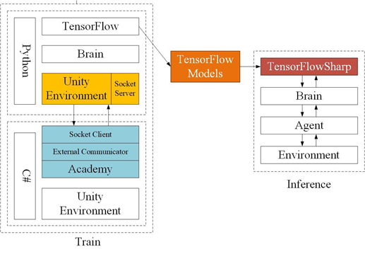
ML-Agents
Unity ML-Agents Structure
Notes:
ML-Agents Unity Machine Learning Agents Toolkit, is an open-source Unity plugin which provides lots of Python API with implementation of game AI. There are three key components of Unity ML-Agents: Learning Environment, Python API and External Communicator. Among them, the Learning Environment includes three additional components that help organize Unity scenarios.

Slide 16
4.
Implementation

Slide 17
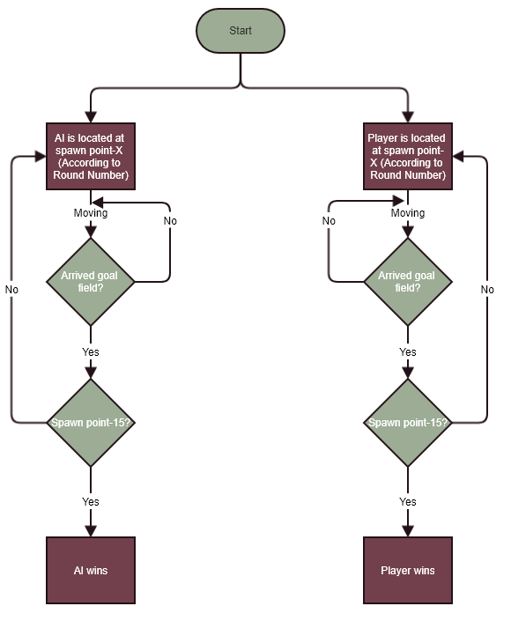
Implementation
Notes:
The game has 15 fixed spawn points, which are located in the border of “Maze”. There spawn points are stored in an array. When the game starts(Round-1), both player and AI will be located in the spawn point-1 ( point number is regarding the Round number). Both AI and player will try to reach goal field. Once they arrive the goal field, the cube will be relocated to next spawn point. By repeating the procedures, if AI or player arrived goal field in Round-15, game over.

Slide 18
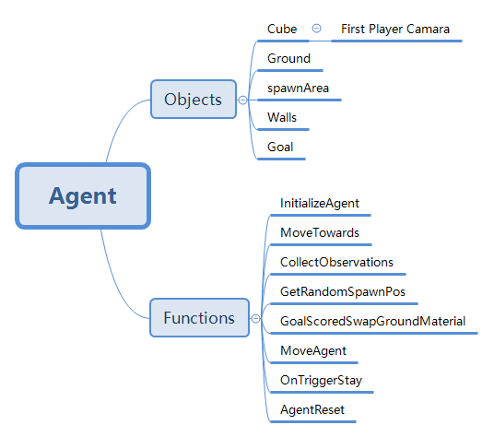
Implementation
Notes:
The AI area contains those objects and functions, which is used in our project.

Slide 19
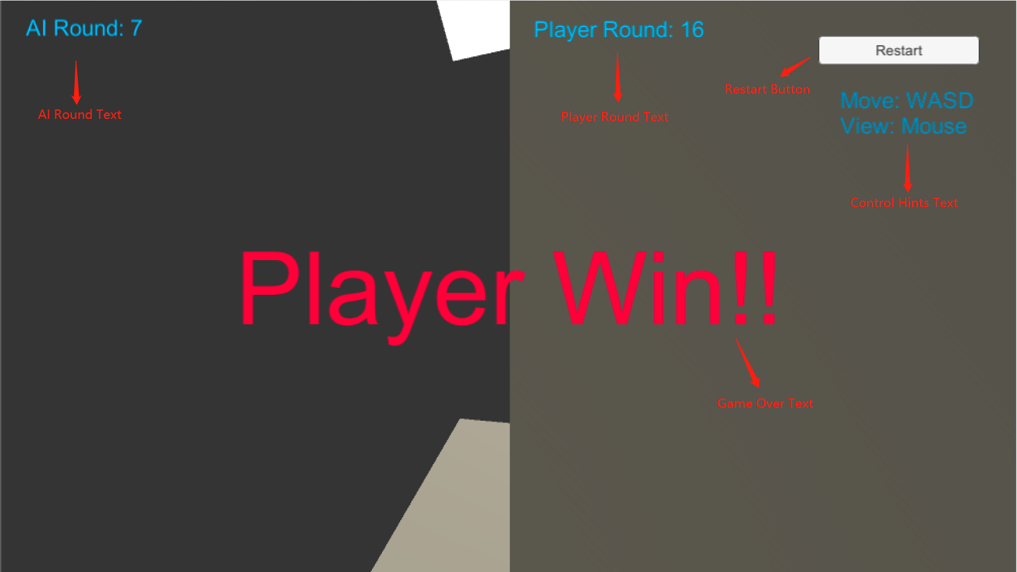
Implementation
Notes:
The user interface contains below parts:
AI Round Text
Player Round Text: Indicating the round number of player.
Restart Button: Restarting game from round-1.
Control Hints Text: Giving some control hints.
Game Over Text: When a player wins, it will show “Player Win!!”. When AI wins, it will show “AI Win!!”.
Game View: the Game view is divided into 2 parts. The left part is AI control view. And right part is player control view.

Slide 20
5.
Demo

Slide 21
Demo Time
https://www.youtube.com/watch?v=lbGGDvMfniw
Notes:
We have uploaded our demonstration video to the Youtube, you may use the link to access to the video.

Slide 22

THANKS!
Any questions?

